Slide 1

CPRG 210 Web Application Development
Module 4: JavaScript Fundamentals

Slide 2
Outlines
JavaScript Concepts
Adding JS to HTML
Inline, <script> inside <head> & <body>, external files
JS Statements
Comments
write(), writeln(), alert(), confirm(), prompt()
Decisions & Loop
Functions

Slide 3
JavaScript: Lightweight Language
Client-Side Programming/Scripting Language
JavaScript
Developed by Netscape in May 1995
Enhancing Functionality and Adding Dynamics
Foundation for Server-Side Scripting
Languages
Used to write programs/Scripts
Statements & Strict Rules (Syntax): Must be Followed (Violation → Syntax Errors
Communication with Computer
Notes:
A lightweight programming language is one that is designed to have very small (small memory space) memory footprint, is easy to implement (important when porting a language), and/or has minimalist syntax and features.

Slide 4
What is a Script?
Program/Script
Set of instructions written by a language & designed to solve a problem or perform a task
Computer can Follow
Software Application: Set of Programs
Programmer: Writing/Implementing Programs
Follow Software Development Process
Learning Programming?
Program Structure
Statements: Syntax & Semantic
Practicing: Solving Many Problems
Code Reuse
Notes:
So, How will students be evaluated? Students will be evaluated on the basis of :
1- What is called Professionalism
2- Students work and practicing in Labs
3- Assignments
a- 15% divided between 5 assignments

Slide 5
Programming Facts
Programmer must perform (1)
Programming
Analysis, Design, Coding, Experiment, Correct, and Redesign
Arts of Things Going Wrong
Programs Rarely Work the 1st Time they are Developed
Try & See → Time
Never Give Up → Time
Syntax vs. Logical Errors
Notes:
So, How will students be evaluated? Students will be evaluated on the basis of :
1- What is called Professionalism
2- Students work and practicing in Labs
3- Assignments
a- 15% divided between 5 assignments

Slide 6

Programming Facts
Program Development: Iterative Process
1. Define the Goal → What do you want to achieve?
2. Design the Script → Identify # of tasks?
3. Coding each Step → Using JavaScript
4. Testing → Program Validity
Developed Programs must be Analytically Correct
SW Development >>> Writing Programs
Notes:
So, How will students be evaluated? Students will be evaluated on the basis of :
1- What is called Professionalism
2- Students work and practicing in Labs
3- Assignments
a- 15% divided between 5 assignments

Slide 7
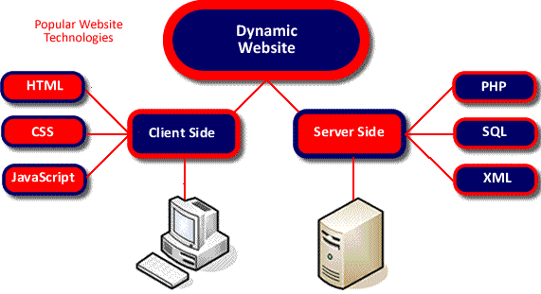
JavaScript Overview
JavaScript: Lightweight Programming Language
Less Memory Space
Client-Side Processing
Minimalist Syntax and Features
Browser Reads and Runs the Code
Easy to Use
No Communication with a Server
Fast & Immediate Response
Client/Server Computing Model
Client-side: JavaScript cannot be hidden from clients
Standardized by European Computer Manufacturer’s Association (ECMA)
Notes:
A lightweight programming language is one that is designed to have very small (small memory space) memory footprint, is easy to implement (important when porting a language), and/or has minimalist syntax and features.

Slide 8
JavaScript Overview
JavaScript & Java
Completely Different Languages
JavaScript: Interpreted
Java is more Powerful & Complex
Program
Input
JavaScript
Dynamically Adding/Changing Page’s Text
Reacting to Events (e.g. Button Click)
Read/Write HTML Elements
Form Validation, Calculations, Clocks
Shopping Carts
Special Graphics and Text Effects
Image Swapping and Slide Show
Creating Cookies and Much More
Interpreter = Browser
Output
Notes:
A lightweight programming language is one that is designed to have very small (small memory space) memory footprint, is easy to implement (important when porting a language), and/or has minimalist syntax and features.

Slide 9
Website: Progressive Enhancement
1
2
3
.html
.css
.js
Content
Styles, Formatting, Presentation
Behavior, Interactivity, or Dynamics
+
Structure
Notes:
It is important to define our terms, most especially for words that everyone thinks they understand.
The terms web and Internet are not synonyms: they refer to completely different things.
“network of networks”.
The physical hardware: the servers, cabling, routers, modems, switches and computers that combine to form the massive network we call the Internet.
physical infrastructure (Pipes) that allows information (Fluid/gas) to flow.
Connected Computers/Networks
Facilitating Information Sharing
Services: Web pages, email, ftp, Chat, Social Network

Slide 10
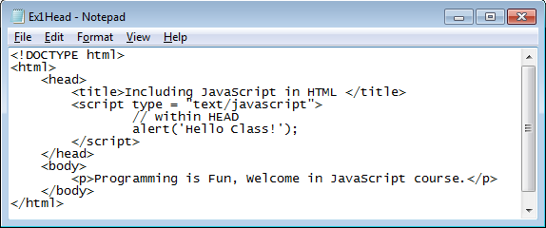
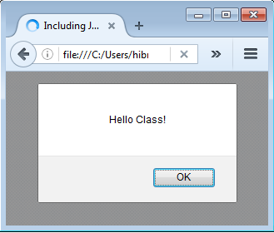
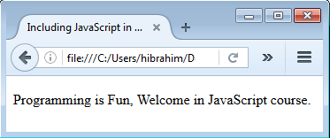
JS Within <HEAD> - <BODY> - Both
<script> Within <HEAD>
<script type=“text/javascript”>
JS statement 1 or code;
JS statement 2 or code;
</script>
Comment
“message”
alert() displays an alert box with a specified message and an OK button.
Functions and code that may execute multiple times is typically placed in the <HEAD>
<script> Within <body>?
Notes:
The execution will be from top to bottom

Slide 11
Including JavaScript in HTML
Script within HTML Document
Visible in the Client Browser
Solution 1: Use External File
<script type = "text/javascript"
src = "file.js"></script>
Solution 2: Use Server Scripting → More Secured
Notes:
Using external file is not totally secured
However, the source is likely still not really hidden In a temp folder somewhere on computer and can be seen with a utility like FireBug Thus you should not "hardcode" into Javascript anything that you don't want the client to see

Slide 12
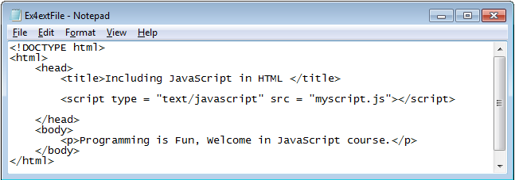
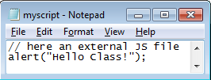
Including JavaScript in HTML
External JS File Example
Don’t Forget File Path if HTML & JS Files in Different Folders
Inline -- inside HTML tags
<input type=“submit” onclick=“validate();” />
Notes:
The message will show up then the paragraph is added.
Using external file is not totally secured
However, the source is likely still not really hidden In a temp folder somewhere on computer and can be seen with a utility like FireBug Thus you should not "hardcode" into Javascript anything that you don't want the client to see

Slide 13
Basic JavaScript Instructions
Instruction
Statement or Command
Each Individual Step in a Script
Terminated with ;
var x;
document.write(‘Hello Class’);
Comments: Ignored by browsers
Single-Line Comments: // ……
Multi-Line Comments: /* ……*/
Notes:
Through INTERNT, you can access many services such as: Web pages, email, ftp, Chat, Social Network
The popular term for the Internet is the “information highway”.
Rather than moving through geographical space, it moves your ideas and information through cyberspace – the space of electronic movement of ideas and information.
Examples/Analogy
Internet: Physical Highways = Communication Media between Computers
Moving Vehicles: Information traveling through Internet Paths

Slide 14
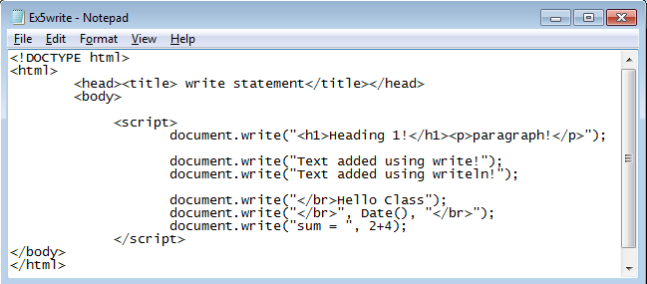
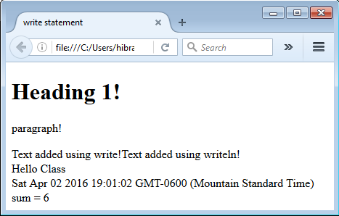
JS Instructions: write() & writeln()
O/P: write()
Writing a Text or HTML Element to HTML Document
write & writeln : Same Function
writeln() adds a new line character (You must use <pre> right before <script>
Notes:
Date() Write the Date object directly to the HTML document:

Slide 15
JS Instructions: alert() & confirm()
O/P: alert()
Display an Alert Box (Popup)
alert(message)
window.alert(“Welcome in JS”);
alert(‘Welcome in JS’);
Argument: variable, string, literal Values
alert(welcomeVar); | alert(5+6);
Display a Confirmation Box
O/P: confirm()
Dialog Box: Message, OK, and Cancel
It Returns:
True if OK is Clicked
False if Cancel is Clicked
Verify that a User Accepts (Ok Button)
Verify that a User Rejects (Cancel Button)
Window.confirm(“Click OK or Cancel”);

Slide 16
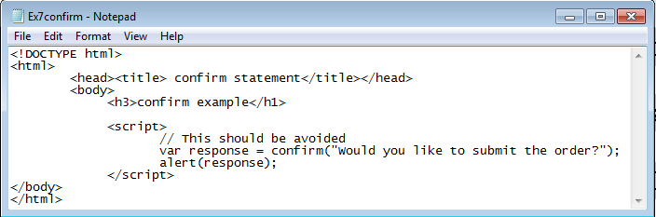
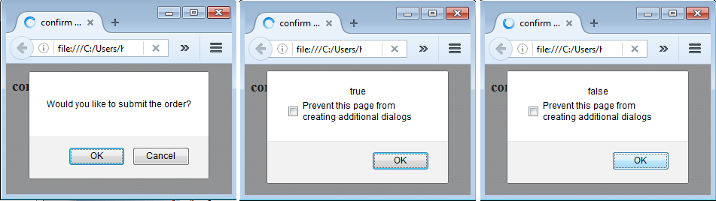
JS Instructions: alert() & confirm()
Window.confirm(“ Enter a ValueClick OK or Cancel”);
OK is Clicked
Cancel is Clicked
Notes:
Through INTERNT, you can access many services such as: Web pages, email, ftp, Chat, Social Network
The popular term for the Internet is the “information highway”.
Rather than moving through geographical space, it moves your ideas and information through cyberspace – the space of electronic movement of ideas and information.
Examples/Analogy
Internet: Physical Highways = Communication Media between Computers
Moving Vehicles: Information traveling through Internet Paths

Slide 17
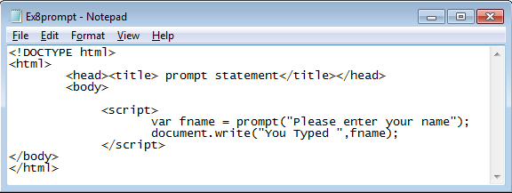
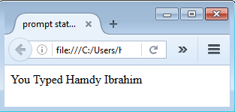
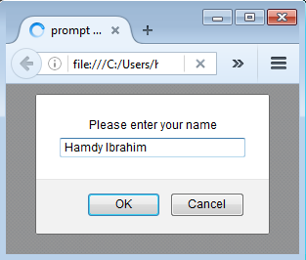
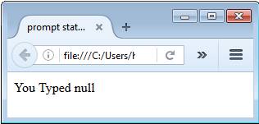
Basic JavaScript Instructions
prompt()
Display Box Asking Users for Input
Click Ok → Returning The Input Value
Click Cancel → Returning NULL
Cancel is Clicked
Notes:
Through INTERNT, you can access many services such as: Web pages, email, ftp, Chat, Social Network
The popular term for the Internet is the “information highway”.
Rather than moving through geographical space, it moves your ideas and information through cyberspace – the space of electronic movement of ideas and information.
Examples/Analogy
Internet: Physical Highways = Communication Media between Computers
Moving Vehicles: Information traveling through Internet Paths

Slide 18
Variables
Memory Location used to store Data
Implicit (Not Advised) or Explicit Declaration using var
var firstValue; var firstValue = 5;
Has a Name, Type, Value, and Scope
var is optional
Usage Steps
Declaration: var qty; var qty = 0; var fname = “John”
JS is a loosely typed language
Access: qty = 10; Totalqty = qty * 3;
Notes:
JavaScript is a loosely typed language, which means you do not declare the data types of variables explicitly. In many cases JavaScript performs conversions automatically when they are needed. For example, if you add a number to an item that consists of text (a string), the number is converted to text.
A variable is a memory place or container to store values
In other programming languages, there is integer, float, char, string variables

Slide 19
Variables: Naming Rule & Scope
Name = Identifier
Short Names or More Descriptive Names | Can Have Letters, Digits, Underscore, $
Must Begin with a Letter, $, _ | Case Sensitive (y does not equal Y)
Reserved Words Cannot Be Used | No Spaces or Special Characters
Access Scope
Local: variable is declared inside a function | Global: variable is declared outside functions
Local: it cab be accessed inside the function only | Global: It can be accessed any where
Notes:
A variable is a memory place or container to store values
In other programming languages, there is integer, float, char, string variables

Slide 20
Variables: Data Types
Data Type | Description | Example
Number | Numeric (Integer or Real) Values | var x = 0.75; var y = -10;
String | Sequence of Characters (Use Single/Double Quotes) | var s1 = ‘Hi Class’, course_name = “JS”;
Boolean | Logical Values (True/False) | var b1 = true, b2 = false;
Array | For Storing Multiple Values in a Single Variable | var course = [“CMPN215", “CMPP257"];
Null | No value - Empty | var x = “”;
Undefined | Variable was declared but no value assigned. | var x; Alert(x);
Object | Non primitive variable containing data & instructions | Details later.
European Computer Manufacturer’s Association (ECMA): Standard definition
Notes:
A variable is a memory place or container to store values
In other programming languages, there is integer, float, char, string variables

Slide 21
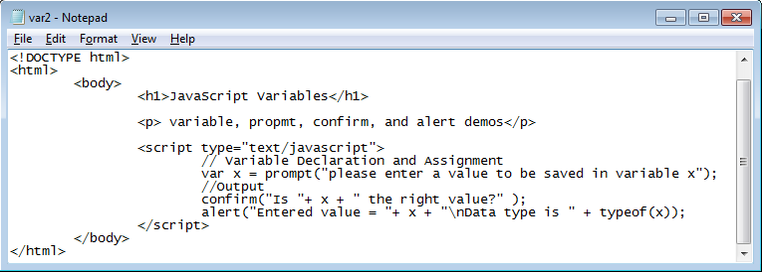
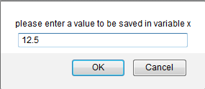
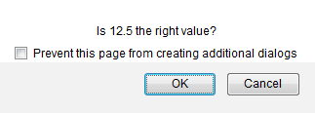
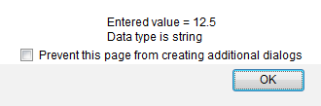
Variables
prompt()
confirm()
alert()
Notes:
The value returned by prompt is string

Slide 22
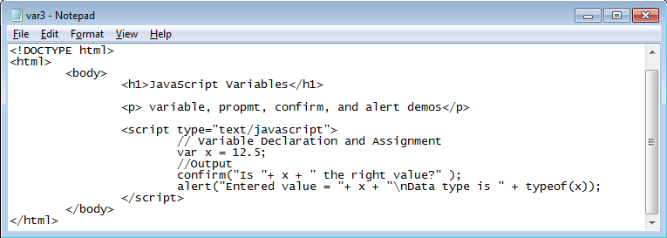

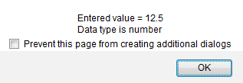
Variables
confirm()
alert()
Notes:
The value returned by prompt is string

Slide 23
Mathematical Expression
Expression
Set of variables, Values, and Operators
Getting Some Calculations Done
var total = 0.9 * retail + gstTax;
Operators
Arithmetic, Comparison, and Logical Operators
Example
var width = 3;
var height = 2;
area = width * height;
Area = 3 * 2 = 6
Notes:
Corresponding to Processing

Slide 24
Mathematical Expression: Operators
Operator | Description | Example | Result (y = 3)
+ | Addition | X = y + 2 | X = 5
- | Subtraction | X = y – 2 | X = 1
* | Multiplication | X = y * 2 | X = 6
/ | Division | X = y /2 | X = 1.5
% | Modulus (Remainder) | X = y % 2 | X = 1
++ | Increment (Pre & Post) | ++y or y++ | y = 4
-- | Decrement (Pre & Post) | --y or y-- | y = 2
- | Negation (Negative) | -y | y = -3
Math.pow() | Exponentiation/Power | X = Math.pow(y,2) → X = 9
Notes:
Math.Pow(4,3) So we do not have exponent operator but there is a method.

Slide 25
Mathematical Expression
Operator Precedence
Operator | Priority
() | 1 – Highest
++, -- | 2
*, /, % | 3
+, - | 4 - Lowest
Order of Performing Operations in Expression
Expression: 4 / 2 + 8 * 4 – (5+2) % 3
1 | 4 / 2 + 8 * 4 – (5+2) % 3
2 | 4 / 2 + 8 * 4 – 7 % 3
3 | 2 + 8 * 4 – 7 % 3
4 | 2 + 32 – 7 % 3
5 | 2 + 32 – 1
6 | 34 – 1 → 33
Expression: 5 + 6 – 11 + 8 * 5 + 4
1 | 5 + 6 – 11 + 8 * 5 + 4
2 | 5 + 6 – 11 + 40 + 4
3 | 11 – 11 + 40 + 4
4 | 0 + 40 + 4
5 | 40 + 4 = 44
Notes:
Math.Pow(4,3)

Slide 26
Mathematical Expression
Concatenation Operator (+)
Joining/Combining Strings
Assignment
Assign a value to a variable or Do Math and Assign the Result
var greeting = ‘Hello‘; var name = ‘Class’; var message = greeting + name;
Message = HelloClass
Operator | Example | Equivalent To
= | X = Y; | X = Y
+= | X += Y; | X = X + Y
-= | X -= Y; | X = X – Y
*= | X *= Y; | X = X * Y
/= | X /= Y; | X = X / Y
%= | X %= Y; | X = X % Y
// prompt returns string
var rate = parseInt(prompt("What is the employee's pay rate? "));`
String
parseInt()
Integer
String
parseFloat()
float
Notes:
Math.Pow(4,3)

Slide 27
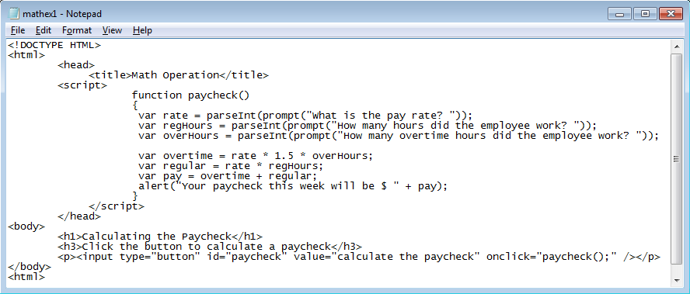
Mathematical Expression
What is the expected output?
Notes:
/*The list-style-type specifies the type of list-item marker in a list.*/
/*The overflow property specifies what happens if content overflows an element's box.*/
/* The text-transform property controls the capitalization of text.*/

Slide 28
Decision: IF Statement
Control / Conditional / Branching
Choice of which statements will be executed based on conditions
If Condition(s) is True → Statement1(s) will be executed
If Condition(s) is False → Do Nothing or Statement2(s) will be executed
if (Condition) { Statement 1;
Statement 2;
Statement m;
}
grade >= 50
true
Display “Passed”
if (grade >= 50) { document.write(‘You passed!’); }
Other JS Statements;
Continue Script
Notes:
Conditional statements are used to perform different actions based on different conditions.

Slide 29
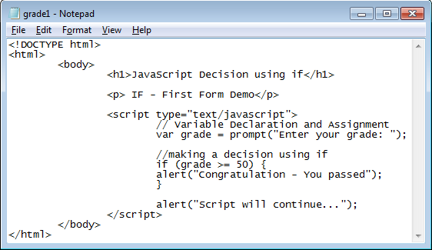
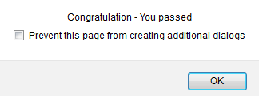
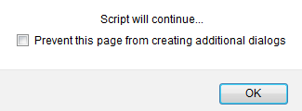
Decisions: If Statement – 1st Form
Will Show up If grade>= 50
Will Show up All the time
Notes:
Block of code to be executed if the condition is true

Slide 30
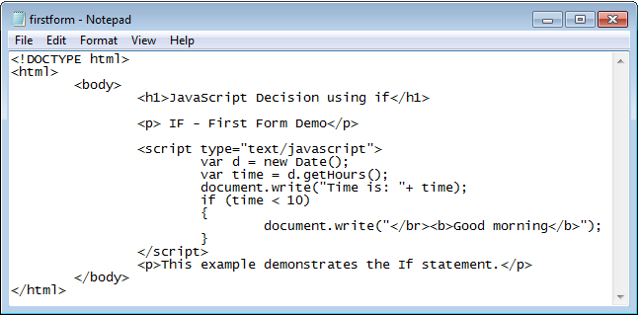
Decisions: If Statement – 1st Form
Trace the script and guess the output
Notes:
If the time on your browser is less than 10, you will get a "Good morning" greeting.

Slide 31
Decisions: If Statement – 1st Form
var price = parseInt(prompt("What is your merchandise total? ")); if (price > 1.00 && price < 25.00)
var ship = 5.00;
if (price >= 25.00 && price < 50.00)
var ship = 7.00;
if (price >= 50.00 && price < 75.00)
var ship = 9.00;
if (price >= 75.00 && price < 100.00)
var ship = 10.00;
if (price >= 100.00)
var ship = 0.00;
document.write("<p>Your shipping cost will be $ " + ship + ".</p>");
AND &&
Cond 1 && Cond 2
Cond 1 | Cond 2 | Result
False | False | False
False | True | False
True | False | False
True | True | True
{} is used in case of block of statements
All conditions will be checked
Notes:
Different shipping fee/charge based on different total prices

Slide 32
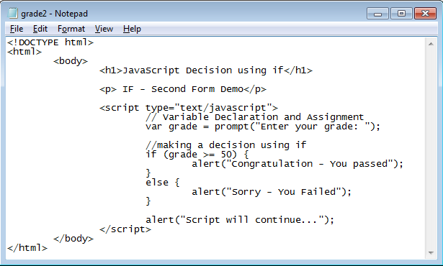
Decisions: If – else (2nd Form)
if (Condition) { Set 1 of Statements;}
else {
Set 2 of Statements;
}
If True
If False
Notes:
Block of code to be executed if the condition is true

Slide 33
Decisions: If – else if - else (3rd Form)
if (Condition) { Set 1 of Statements;
} else if (condition) {
Set 2 of Statements;
} else {
Set 3 of statements;
}
Syntax
var rate = parseInt(prompt("Rate the site from 1 to 10, with 10 as the best")); var grade = " “; // initialize grade
if (rate == 10)
grade = "A";
else if (rate >= 7 && rate <= 9)
grade = "B";
else if (rate >= 4 && rate < 7)
grade = "C";
else
grade = "D";
document.write("<p>You gave the site a rating of " + grade + ".</p>");
Notes:
if...else if....else statement - use this statement to select one of many blocks of code to be executed

Slide 34
Decisions: If Statement
Comparison Operators
Operator | Description | Example (var score = 50) | Returns
== | Equal to | Score == 50 | True
 |  | Score == “50” | True
=== | Equal value and equal type | Score === 50 | True
 |  | Score === “50” | False
!= | Not Equal | Score != 80 | True
!== | Not equal value or not equal type | Score !== 50 | False
 |  | Score !== “50” | True
 |  | Score !== 80 | True
 |  | Score !== 50 | False
Notes:
It is also called branching, control, or conditional statements

Slide 35
Decisions: If Statement
Comparison Operators
Operator | Description | Example (var score = 50) | Returns
> | Greater than | Score > 40 | True
 |  | Score > 50 | False
< | Less than | Score < 60 | True
 |  | Score < 50 | False
>= | Greater than or equal to | Score >= 50 | True
 |  | Score > 40 | True
 |  | Score >= 60 | False
<= | Less than or equal to | Score <= 50 | True
 |  | Score <= 60 | True
 |  | Score <= 40 | False
Notes:
It is also called branching, control, or conditional statements

Slide 36
Decisions: If Statement – Logical Operators
AND
OR
Binary Operator
Cond 1 && Cond 2
Cond 1 | Cond 2 | Result
False | False | False
False | True | False
True | False | False
True | True | True
Cond 1 || Cond 2
Cond 1 | Cond 2 | Result
False | False | False
False | True | True
True | False | True
True | True | True
(&&, ||) used to Combine Conditions
Unary
Cond 1 | ! (Cond 1)
False | True
True | False
NOT
Notes:
Operands

Slide 37
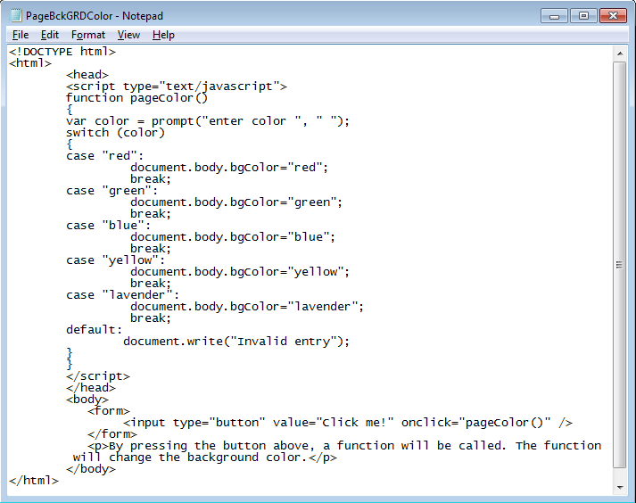
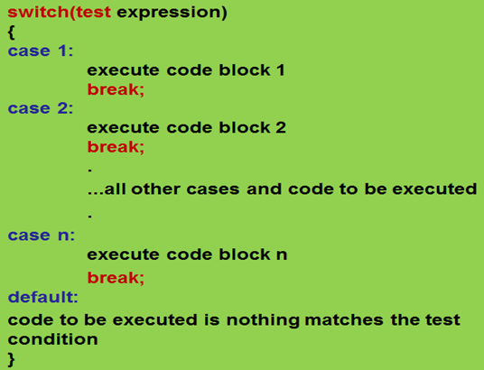
Decisions: switch Statement
Changing background color of the body
Same Function as if-else-if
Notes:
Don’t foget the template → creating at least a button when it is clicked the function is called and may be some html elements
PageBckGRDColor.html

Slide 38
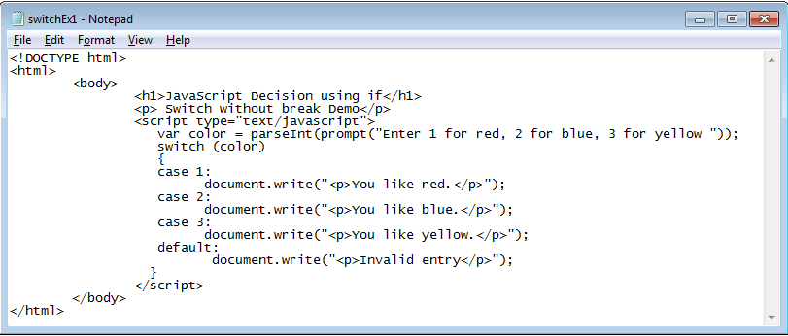
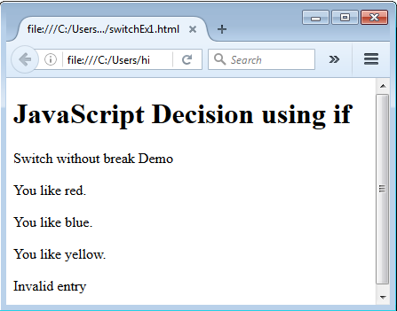
Decisions: switch Statement
Without the break statement, all following cases will be executed!
Please try it
Search for Conditional Operator “?”
Notes:
Must include break after each case

Slide 39
Functions
Group of statements → perform task
Executed by a condition/unconditional call
Can be called anywhere
Recommended to be defined in <HEAD>
Function receives values and returns Only one value
Reusable → Saving Time
Easier to read, understand, and maintain
Functions Types
Built-In:
parseInt() parseFloat()
User-Defined:
getInput()
product(a,b)
Notes:
Number of lines of code is reduced
Code becomes easier to read & understand
Code becomes easier to maintain as changes need to be made only at a single location instead multiple locations
A function will be executed by an event or by a call to the function
•To keep the browser from executing a script when the page loads, you can put your script into a function.
•A function contains code that will be executed by an event or by a call to the function.
•You may call a function from anywhere within a page (or even from other pages if the function is embedded in an external .js file).
Functions let you group a series of statements together to perform a specific task.
•Functions can be defined both in the <head> and in the <body> section of a document.
Functions are reusable and save you from writing out the same code over and over.
A function will be executed by an event or by a call to the function
•To keep the browser from executing a script when the page loads, you can put your script into a function.
•A function contains code that will be executed by an event or by a call to the function.
•You may call a function from anywhere within a page (or even from other pages if the function is embedded in an external .js file).
Functions let you group a series of statements together to perform a specific task.
•Functions can be defined both in the <head> and in the <body> section of a document.
Functions are reusable and save you from writing out the same code over and over.

Slide 40
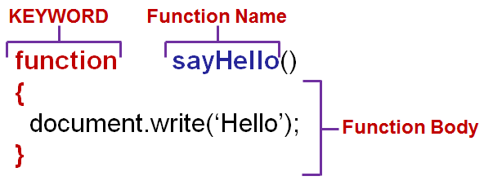
Functions: Usage
1. Declaration/ Definition
Function Header
2. Function Calling
Use Function Name to Call→ sayHello();
Notes:
A function will be executed by an event or by a call to the function
•To keep the browser from executing a script when the page loads, you can put your script into a function.
•A function contains code that will be executed by an event or by a call to the function.
•You may call a function from anywhere within a page (or even from other pages if the function is embedded in an external .js file).
Functions let you group a series of statements together to perform a specific task.
•Functions can be defined both in the <head> and in the <body> section of a document.
Functions are reusable and save you from writing out the same code over and over.

Slide 41
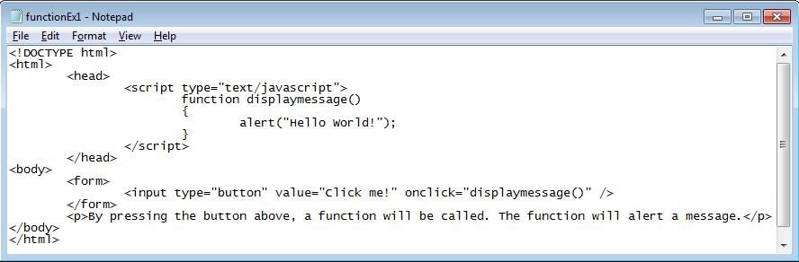
Functions: Example
Conditional Call
Notes:
<html>
<head>
<script type="text/javascript">
function displaymessage()
{
alert("Hello World!");
}
</script>
</head>
<body>
<form>
<input type="button" value="Click me!" onclick="displaymessage()" />
</form>
<p>By pressing the button above, a function will be called. The function will alert a message.</p>
</body>
</html>
A function will be executed by an event or by a call to the function
•To keep the browser from executing a script when the page loads, you can put your script into a function.
•A function contains code that will be executed by an event or by a call to the function.
•You may call a function from anywhere within a page (or even from other pages if the function is embedded in an external .js file).
Functions let you group a series of statements together to perform a specific task.
•Functions can be defined both in the <head> and in the <body> section of a document.
Functions are reusable and save you from writing out the same code over and over.

Slide 42
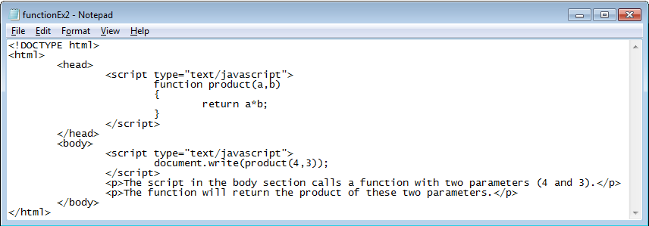
Functions: Receiving & Returning
Two Parameters: a,b
Return Value: a*b
product(4,3) will be replaced by a*b
Passed Values: 4,3
product(4,3) will be replaced by a*b
Notes:
A function will be executed by an event or by a call to the function
•To keep the browser from executing a script when the page loads, you can put your script into a function.
•A function contains code that will be executed by an event or by a call to the function.
•You may call a function from anywhere within a page (or even from other pages if the function is embedded in an external .js file).
Functions let you group a series of statements together to perform a specific task.
•Functions can be defined both in the <head> and in the <body> section of a document.
Functions are reusable and save you from writing out the same code over and over.

Slide 43
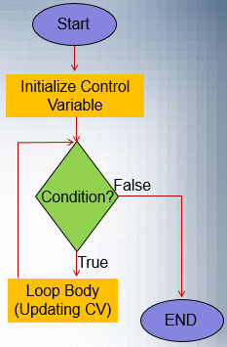
Loop
Iterative/Repetition → Reducing LOC
Conditionally Executing Block of Code Multiple Times
Each Single Execution Path → Iteration
Has a Body, Condition, Control Variable
Examples
Calculating GPA for 100 Students (100 iterations)
GPA Calculation is Repeated 100 Times
Adding 4 Items to Purchasing Cart
Pre-Test Loop: Condition is Tested First
Continually Repeat Instructions Until a Certain Condition is Reached.
Notes:
Loops execute a block of code a specified number of times, or while a specified condition is true.

Slide 44
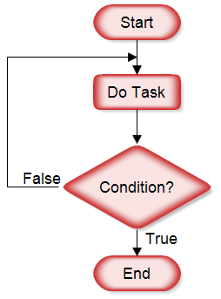
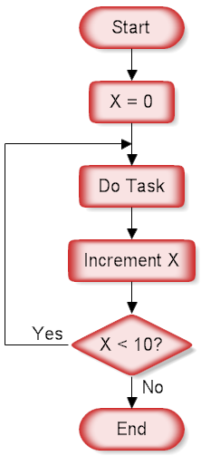
Loop
Infinite Loop: Loop Never Terminate
Caused by Invalid Conditions
Caused by Failing to Update the Control Variable Properly
Post-Test Loop: Loop Body is Executed at Least Once before Testing the Condition
Notes:
Loops execute a block of code a specified number of times, or while a specified condition is true.

Slide 45
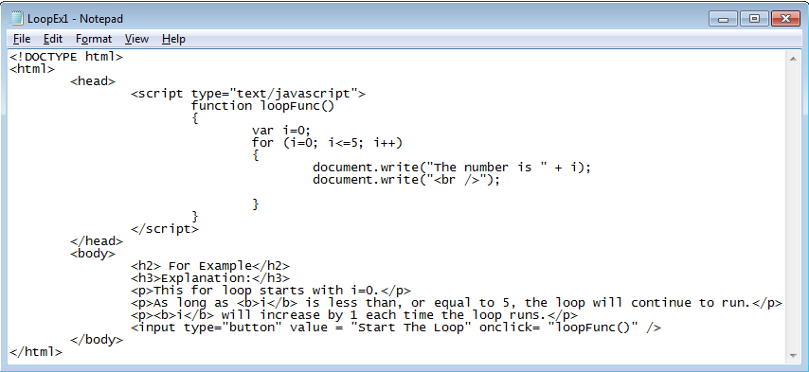
Loop: FOR Statement
for :Pre-Test
for(Initialization; Conditions; Update) { Statements}
Notes:
Trace the Execution on the Board

Slide 46
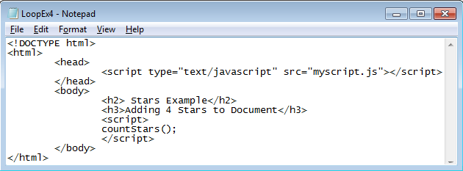
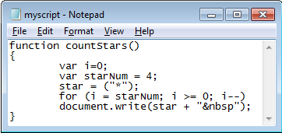
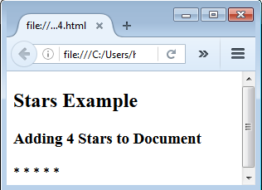
Loop: FOR Statement
Using External File
i is initially set to 4
Notes:
Loop can be written in different ways and implement the same function. &nbsp → adding spaces between stars

Slide 47
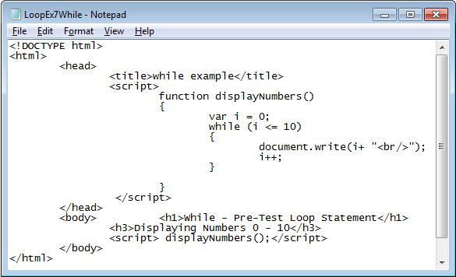
Loop: WHILE Statement
while :Pre-Test
Initialization
Condition
Update
Post-Test: do-while → Use do-while in the above example
Notes:
Trace the Execution on the Board

Slide 48
DO-WHILE Statement
<html> <head> <title>Payroll</title> <script> function getPay() { document.write('<table width="40%" align = "center">'); var name = " "; var hours = 0; var rate = 0; var grossPay = 0; var netPay = 0; document.write('<tr><td>name</td><td>gross pay</td><td>net pay</td></tr>');
name = prompt("Enter the first employee's name:");
do { hours = parseFloat(prompt("How many hours did " + name + " work this week?"));
rate = parseFloat(prompt("What is " + name + "'s hourly pay rate?"));
if (hours > 40) grossPay = (40 * rate) + ((hours - 40) * 1.5 * rate); else grossPay = hours * rate; netPay = grossPay * .85; document.write('<tr><td>' + name + '</td><td>$ ' + grossPay + '</td><td>$ ' + netPay + '</td></tr>');
name = prompt("Enter another employee's name or enter 'done' when finished:");
} while (name != "done") document.write('</table>'); } </script> </head> <body> <h1>Calculate Employees Paychecks</h1> <p>You can enter payroll information for all employees. Paychecks are calculated as shown:</p>
<p>OUTPUT GOES HERE</p> <p><input type="button" id="pay" value="Click to begin entering employees" onclick="getPay();" /></p>
</body> </html>
Notes:
LoopEx9do.html → toUpperCase() and toLowerCase()
The script will create a table of employees paycheck. The table will have three columns:Name, Gross Pay, and Net Pay
You keep getting the pay information of employees till you entered done.
There is a logical error ask students how they can fix it

Slide 49
That’s all for today
Exercise: Review
Do the exercises in “CPRG210 Exercises Day 4.doc”
Notes:
The continue statement will break the current loop and continue with the next value.
When I = 4, the rest of the loop will not be executed and will move to the next iteration (I = 5)

